Slide 1
STRATEGIC MARKETING
Enhancing Employability via Personal Branding
Prof. Mohammed Rafiq
Professor of Marketing
Notes:
Hello and welcome to todays lecture on Segmentation, Targeting and Positioning.

Slide 2
Personal Branding
Topic outline
What is Branding?
What is Personal Branding?
Importance of Personal Branding
How to Create A personal Brand
Notes:
This lecture discusses the role of market Segmentation, Market Targeting and Differentiation and positioning in creating value for target customers

Slide 3

Highlights of the week – Monday, 4 November
Live brief with Impact: The Local Government Graduate Programme
Time: 14:00–16:00 Location: MA002, Mandela Building, Digby Stuart College
Years: Levels 5 and 6
Tips and tricks for answering work related scenario questions and situational judgement tests: A local government perspective
Link: https://app.joinhandshake.co.uk/stu/events/43306 (registration required)
University of Roehampton | FBL

Slide 4

Breakdown of all events and registration links also appear on the
NEST calendar
University of Roehampton | FBL

Slide 5
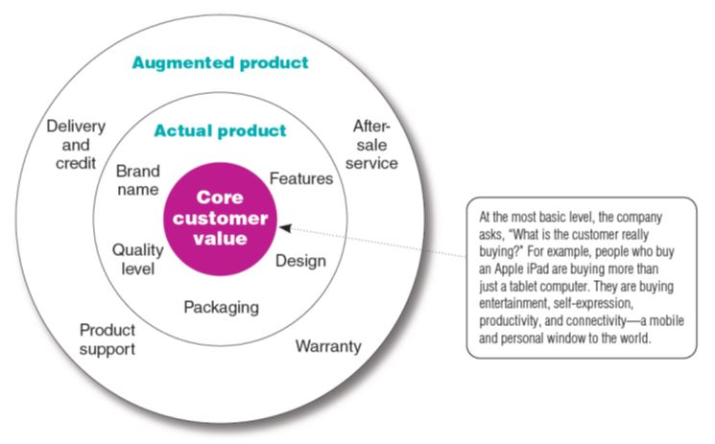
What Is a Product?
Levels of Product and Services
FIGURE | 8.1
Three Levels of Product
8-8
Notes:
Product planners need to think about products and services on three levels (see Figure 8.1). Each level adds more customer value. The most basic level is the core customer value, which addresses the question: What is the buyer really buying?
At the second level, product planners must turn the core benefit into an actual product. They need to develop product and service features, a design, a quality level, a brand name, and packaging.
Finally, product planners must build an augmented product around the core benefit and actual product by offering additional consumer services and benefits.
Discussion Question
It is a good idea for the students to bring in some products so the class can discuss the levels of product and services. Products including Gatorade, toothpaste, facial moisturizer, or cosmetics work well in this discussion. You can often find augmented product features on product websites including games, features, and support.

Slide 6


What is a Brand
Brand is the name, term, sign, or design or a combination of these, that identifies the maker or seller of a product or service.
Copyright © 2016 Pearson Education, Inc.
8-28
Notes:
Discussion Questions
What brands do you tend to purchase consistently? Why?
This discussion should lead to the consumer benefits of brands including quality and consistency. It is interesting to now ask students what the benefits might be for the seller of a strong brand. This will include segmentation, positioning, and the ability to communicate product features.
Consumers view a brand as an important part of a product, and branding can add value to a consumer’s purchase. Customers attach meanings to brands and develop brand relationships. Branding has become so strong that today hardly anything goes unbranded. Brand names help consumers identify products that might benefit them and say something about product quality and consistency.
Branding also gives the seller several advantages. The seller’s brand name and trademark provide legal protection for unique product features that otherwise might be copied by competitors. Branding helps the seller to segment markets.

Slide 7
The Value of Branding
To Buyers
• Helps speed consumer purchases by identifying specific preferred products
• Facilitates Evaluation of product quality to reduce the risk of purchase
• Provides a form of self-expression and status
To Sellers
• Identifies and differentiates a firm’s products from competing products
• Helps in the introduction of new products
• Facilitates the promotion of all same-brand products
• Fosters the development of brand loyalty

Slide 8
Differentiation and positioning
Product positioning is the way the product is defined by consumers on important attributes—the place the product occupies in consumers’ minds relative to competing products.
Perceptions
Impressions
Feelings.
Notes:
Notes to Instructor:
Tide is positioned as a powerful, all-purpose family detergent; Ivory is positioned as the gentle detergent for fine washables and baby clothes.
At Subway restaurants, you ‘Eat Fresh;’ at Olive Garden, ‘When You’re Here, You’re Family;’ and at Applebee’s you’re ‘Eatin Good in the Neighborhood.’ In the automobile market, the Nissan Versa and Honda Fit are positioned on economy, Mercedes and Cadillac on luxury and Porsche and BMW on performance. Volvo positions powerfully on safety. And Toyota positions its fuel efficient, hybrid Prius as a high-tech solution to the energy shortage. ‘How far will you go to save the planet?’ it asks.

Slide 9
Building Strong Brands
Branding Strategy: Building Strong Brands
Brand Positioning
Marketers can position brands at any of three levels.
Attributes
Benefits
Beliefs and values
Copyright © 2016 Pearson Education, Inc.
8-49
Notes:
Marketers need to position their brands clearly in target customers’ minds. They can position brands at any of three levels.
At the lowest level, they can position the brand on product attributes. For example, P&G’s Pampers’ early marketing focused on attributes such as fluid absorption, fit, and disposability. Attributes are the least desirable level for brand positioning because competitors can easily copy attributes. Customers are not interested in what the attributes are—they are interested in what the attributes will do for them.
A brand can be better positioned by associating its name with a desirable benefit. Thus, Pampers can go beyond technical product attributes and talk about the resulting containment and skin-health benefits from dryness.
The strongest brands are positioned on strong beliefs and values, engaging customers on a deep, emotional level. For example ,Pampers is positioned as a “love, sleep, and play brand where we grow together” that’s concerned about happy babies, parent-child relationships, and total baby care.
Successful brands engage customers on a deep, emotional level. Brands ranging from Apple, Google, Disney, and Coca-Cola to Google and Pinterest have achieved this status with many of their customers. Customers don’t just like these brands, they have strong emotional connections with them and love them unconditionally.
When positioning a brand, the marketer should establish a mission for the brand and a vision of what the brand must be and do. A brand is the company’s promise to deliver a specific set of features, benefits, services, and experiences consistently to buyers. The brand promise must be simple and honest

Slide 10
Brand Loyalty
• A customer’s favorable attitude toward a specific brand.
• Recognition: aware brand exists and is alternative if preferred brand unavailable
• Preference: preferred over competitive offerings
• Insistence: strongly preferred, no substitute
Willingness to pay more
Say Positive things about the brand

Slide 11
Brand Equity
Value to the Consumer
Information Processing
Confidence
Satisfaction
Brand Loyalty
Brand Awareness
Brand
Equity
Perceived Quality
Value to the Firm
Efficiency
Margins
Trade Leverage
Competitive Advantage
Brand Associations
Other
Brand Assets
Source: Aaker, D.A. (1991) Managing Brand Equity. New York: Free Press.
Notes:
In the longer run, effective branding enhances Brand Equity or the market value of the Brand.
Effective branding leads to brand loyalty, brand awareness, perceptions of quality and positive brand associations which in combination lead to brand equity.
For customers, retail branding reduces information processing required , increases consumer confidence by reducing perceived risk and increases brand satisfaction.
This reduces marketing costs, increases margins, increases power in the supply chain and importantly gives retailer competitive advantage over its rivals.

Slide 12
What Is Personal Branding?
Personal branding is the intentional, strategic practice of defining and expressing your value.
“It’s the amalgamation of the associations, beliefs, feelings, attitudes, and expectations that people collectively hold about you,”
Source: Avery, J and Greenwald, (2023) “A new Approach to Building Your Personal Brand” Harvard Business Review (May-June).

Slide 13
Why Is Personal Branding Important?
By determining your unique value and living in a way that promotes it, you can become known for your defining attributes.
That reputation can help attract opportunities in your career and life that align with your authentic self.

Slide 14
Define Your Purpose
The first step to creating your personal brand is identifying your values, goals, and purpose. Start by asking yourself:
What do I care about?
What are my values?
What do I want people to know about me?
How do I want to define myself?
What makes me special?
How do I provide value to others?

Slide 15
Audit Your Personal Brand Equity
Next, take stock of your current personal brand. Even before consciously deciding to craft one, others carry perceptions and knowledge about you.
Credentials: Your education, awards, and achievements
Social capital: Personal and professional connections’ quantity and quality
Cultural capital: Emotional intelligence and expertise you’ve garnered through life experiences

Slide 16
Communicate and Embody Your Brand
After planning your personal brand, communicate it by identifying outlets through which you can promote your value.
Just like marketing products and services, you can use a mix of paid, owned, and earned media to make your value proposition and stories accessible and visible to a wider network.
Word of Mouth Promotion
You can also communicate your personal brand by embodying it in face-to-face interactions. Think of them as chances to show who you are. For instance,

Slide 17
Socialize Your Brand
While you are your best advocate, the next step of personal branding is making sure others share your value. Key groups that can be instrumental in socializing your brand:
Gatekeepers: Those whose buy-in is critical to reaching your goals
Influencers: People with authority who can provide additional platforms for sharing your brand
Promoters: Those who actively support pursuing your goals
Communities: Groups who share your mission or interests or seek the value you provide

Slide 18
Reevaluate and Adjust
Personal branding isn’t a one-time project—it requires continually reassessing and adjusting to ensure you live and project your intended brand.
Enlist people you trust to help you reevaluate and describe your brand and value, such as
co-workers,
friends,
and industry connections.

Slide 19
Define Your Value and Make an Impact
A strong personal brand can help you attract the right people, land a job or promotion, and make connections that lead to new opportunities.
With reflection and intentional actions, you can gain confidence in your personal value and project it in your life and career.

Slide 20
PARADOXICALLY IT’S NOT REALLY ABOUT YOU!
PERSONAL BRANDING
A strong personal brand communicates what’s important to potential employers, not to you personally.
CORE MESSAGING
Effective communications speak to the recipient’s needs, not necessarily yours.
NETWORKING
The best way to build brand awareness is to network in such a way that the people you’re contacting feel that they are getting as much value from the relationship as you are.

Slide 21
Personal Branding Videos
What is Personal Branding?
Personal Branding - why is it important?

Slide 22
READING
Avery, J and Greenwald, (2023) “A new Approach to Building Your Personal Brand” Harvard Business Review (May-June).
Manai, Aicha and Holmlund, Maria (2015), Self-Marketing Brand Skills for Business Students, Marketing Intelligence & Planning, Vol. 33, Iss.5, 749-762. DOI: http://dx.doi.org/10.1108/MIP-09-2013-0141.

